Slide 1

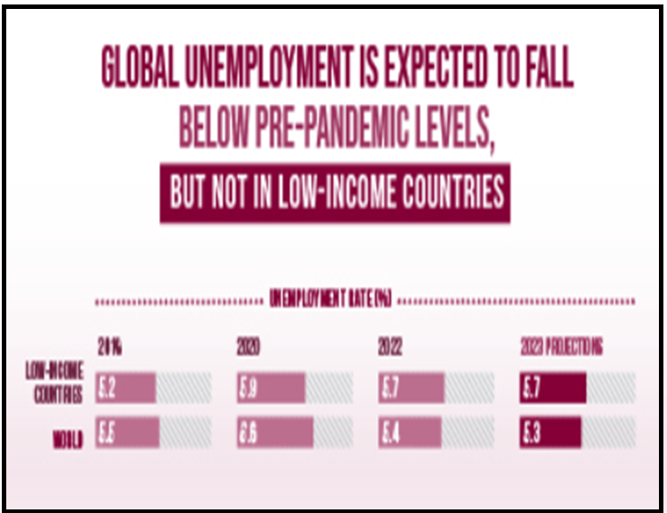
United Nations Sustainable Development Goals
Relevant skills for employment
Finding the most suitable job

Slide 2
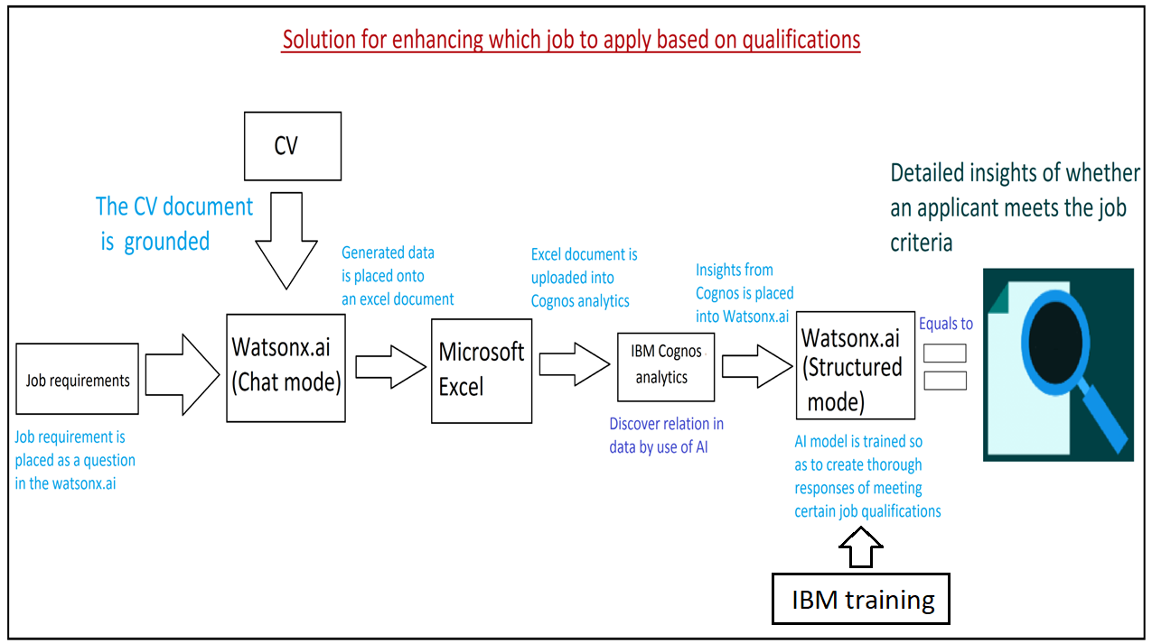

Slide 3
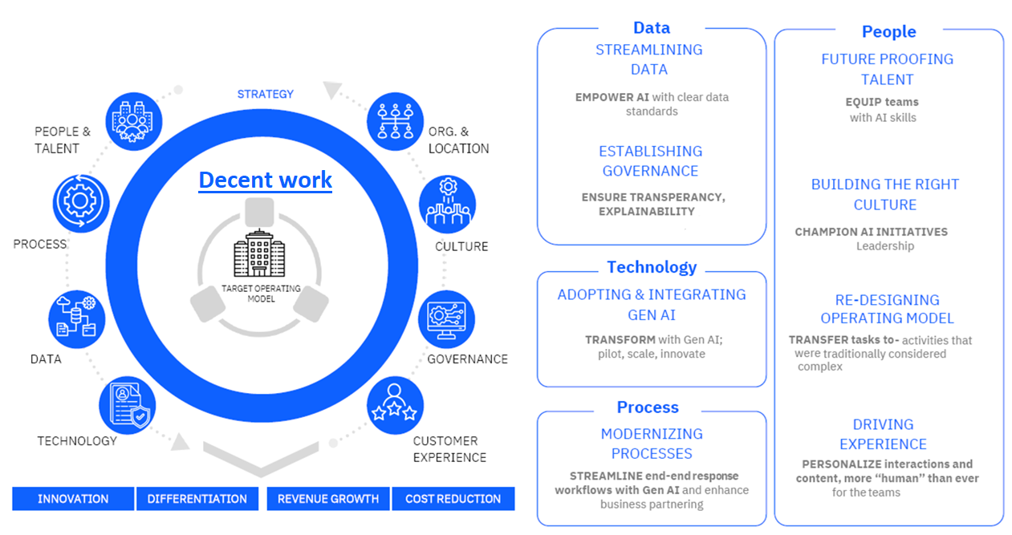
Feasibility

Slide 4
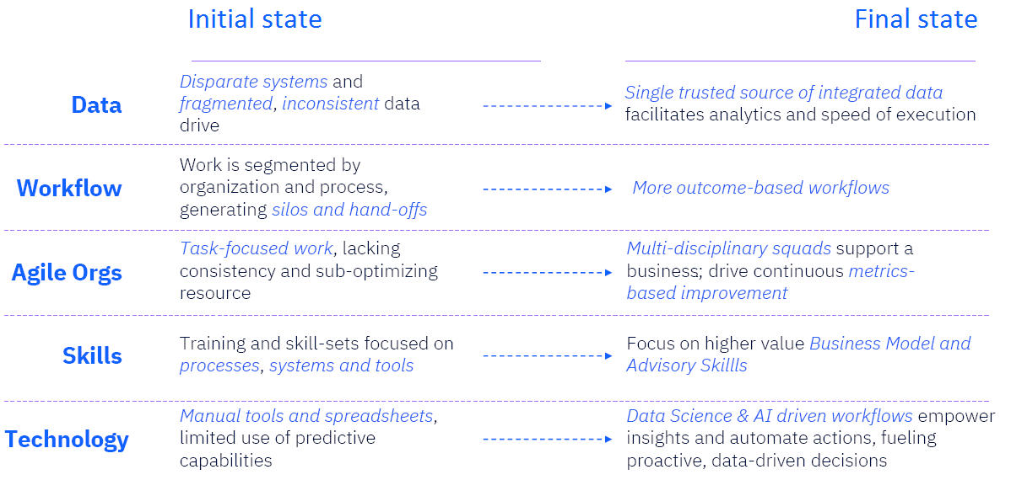
Design and usability

Slide 5
